Slide 1
Welcome to
Computer Science 32
Lecture #1
Professor: Carey Nachenberg (Please call me “Carey”)
E-mail: climberkip@gmail.com
Class info: M/W 10am-12pm, 3400 Boelter Hall
Office hours: 4549 Boelter Hall
My Office: 4531N Boelter Hall
Mondays 12pm-1pm (after class) Wednesdays 9am-10am (before class)

Slide 2
Pick a # between 1 - 60
16 21 26 31 52 57
17 22 27 48 53 58
18 23 28 49 54 59
19 24 29 50 55 60
20 25 30 51 56 *
4 13 22 31 44 53
5 14 23 36 45 54
6 15 28 37 46 55
7 20 29 38 47 60
12 21 30 39 52 *
Your number is…
2 11 22 31 42 51
3 14 23 34 43 54
6 15 26 35 46 55
7 18 27 38 47 58
10 19 30 39 50 59
8 13 26 31 44 57
9 14 27 40 45 58
10 15 28 41 46 59
11 24 29 42 47 60
12 25 30 43 56 *
32 37 42 47 52 57
33 38 43 48 53 58
34 39 44 49 54 59
35 40 45 50 55 60
36 41 46 51 56 *
1 11 21 31 41 51
3 13 23 33 43 53
5 15 25 35 45 55
7 17 27 37 47 57
9 19 29 39 49 59

Slide 3

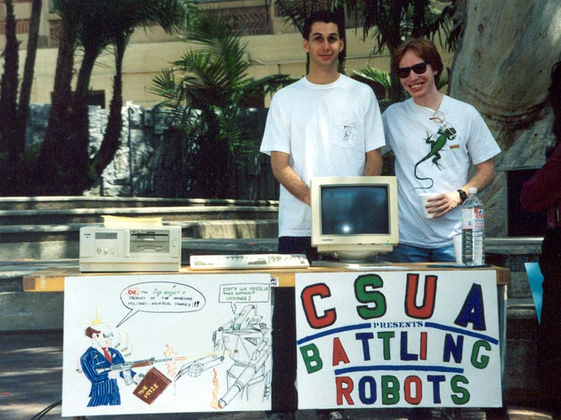
Who Am I?
Carey Nachenberg
Age: 43
School: BS, MS (No PhD!) in CS/E, UCLA ’95
Work: UCLA: Adjunct Prof
Symantec: Vice President
Hobbies: Rock climbing,
teaching CS, publishing a novel!
My goal: To get you excited about programming!

Slide 4
Class Website
Official Class Website: http://www.cs.ucla.edu/classes/winter15/cs32/
You should check the Official Class Website at least 2-3 times a week for homework info, projects, etc.
I will not always announce homework/projects so you have to track this on your own and be on top of the trash!
I’ll post my PowerPoint slides on my private website: http://careynachenberg.com

Slide 5
What You’ll Learn in CS32
Advanced C++ Topics
You’ll learn advanced C++ and Object Oriented Programming
Data Structures
You’ll learn the major data structures (e.g., lists, trees)
Algorithms
You’ll learn the major algorithms (e.g., sorting, searching)
Building Big Programs
You’ll learn how to write large (> 500 lines of code) programs
Basically, once you complete CS32, you’ll know 95% of what you need to succeed in industry!

Slide 6
Important Dates
Project #1: Due Tues, Jan 13th (next tues!)
Midterm #1: Wed, Jan 28th Two choices: 5-6:05pm OR 5:45-6:50pm (You must sign up 1 week in advance for either midterm)
Midterm #2: Mon, Feb 23rd Two choices: 5-6:05pm OR 5:45-6:50pm (You must sign up 1 week in advance for either midterm)
Final Exam: Sat, March 14th One choice: 11:30-2:30pm (This is the Saturday BEFORE Final’s Week. Don’t forget!)

Slide 7

Project #1: Due Tues, Jan 13th
Your first CS32 project is already posted on the class website and is due next Tues!
In P1, we provide you with a simple C++ program.
Your job is to get the program compiling and then make a few changes to it.
The goal of P1 is to allow you to self-evaluate to see if you’re ready for CS32.
Drop the class, review your C++ this quarter and take CS32 in Spring, or
Suffer… Based on history, if you have problems on P1, you’ll get a C or lower in CS32… ☹
If you feel lost on P1…
You should seriously consider one of two things:

Slide 8

Grading, Curve, etc.
The average student will get a B- in this class, unless:
1. The average student is really, really good OR
2. The average student is really, really bad.
If everyone does well, everyone gets an A.
But be careful! CS32 is a weeder class and can easily take 30-40 hours per week of work! Don’t slack!

Slide 9


Academic Integrity Agreement
Read the agreement. Don’t get burned!

Slide 10
Project Grading Policy
To prevent people from cheating on projects (we catch someone in CS32 every year!), we now use the following grading policy:
First, we compute the avg of your midterm & final exam scores.
E.g. You got 60% and 40% on your exams, so your avg. is 50%.
We then cap you MAXIMUM project grade at 30% above your average exam grade.
In this case, the highest points you could get for your projects would be 80%, which is 30% higher than your exam average.
(Even if you got a 99% on your projects)

Slide 11
Compilers, Compilers, Compilers!
You must make sure that all programs you turn in compile and work with both Visual C++ and gcc (under linux or Mac)!
Note: Make sure your projects work with both compilers at least a day or two before submitting them!
You can get a free copy of Visual C++ from: http://www.visualstudio.com/downloads/download-visual-studio-vs#d-express-windows-desktop
You can get a free copy of Apple Xcode/gcc from: http://developer.apple.com/xcode/
You can also use gcc and Visual C++ in the lab.

Slide 12



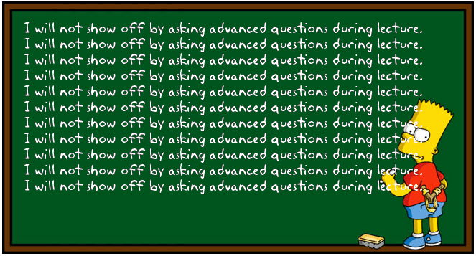




Carey’s Thoughts on Teaching
It’s more important that everyone understand a topic than I finish a lecture on time.
Blah blah blah blah blah
Don’t be shy!!!
If something confuses you…
?
?
?
?
?
it probably confuses 5 other people too.
So always ask questions if you’re confused!
Always save more advanced questions for office hours or break.
I reserve the right to wait until office hours to answer advanced questions.

Slide 13
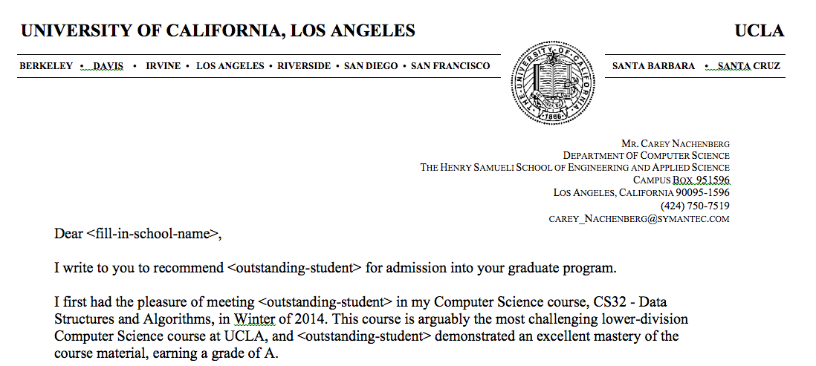
Letters of Recommendation
If you want a letter of recommendation from me…
Make sure to come to office hours every week so I get to know you: your hobbies, accomplishments, goals, etc!
If I don’t know you extremely well, I won’t write a letter!
(Oh, and also make sure to get an A in CS32 ☺)

Slide 14

Time for CS
Alright… Enough administration.
It’s time to do some Computer Science.
To get you back into the CS mood, let’s do a challenge problem! (oh boy)

Slide 15
Class Challenge
A Fibonacci sequence is a list of numbers where the first two numbers are 0 and 1. Each successive number is the sum of the previous two numbers:
You can work in pairs on this problem.
0, 1, 1, 2, 3, 5, 8, 13, etc…
And, the prize is… $2.
Write a function called isFib that accepts an array of 20 integers as an argument, and returns a boolean result.
The function should return true if the array holds the first 20 Fibonacci numbers and false otherwise.
Example:
int arr[20] = {0,1,1,2,3,5,8,13,21,…};
if (isFib (arr) == true)
cout << “We have a winner!”;

Slide 16
Challenge: Answer
bool isFib (int arr[]) {
int j;
if (arr[0] != 0 || arr[1] != 1)
return(false);
for ( j=2 ; j < 20 ; j++)
{
if (arr[j] != arr[j-1] + arr[j-2])
return(false);
}
return(true);
}

Slide 17
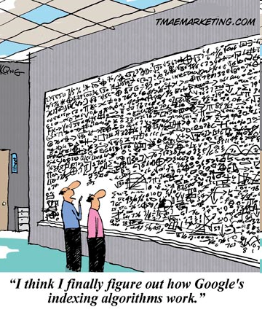
Algorithms and Data Structures

Slide 18



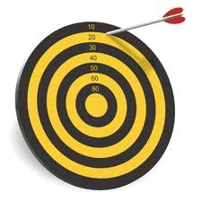
What is an Algorithm
An algorithm is a set of instructions/steps that solve a particular problem.
Each algorithm operates on input data.
42
Each algorithm produces an output result.
Each algorithm can be classified by how long it takes to run on a particular input.
Each algorithm can be classified by the quality of its results.

Slide 19
Consider our Fibonacci Algorithm
Verify the first number is a zero
Verify the second number is a one
For the third through Nth numbers:
Verify that each value is equal to the sum of the previous two values
Here are the steps:
The input:
An array of integers
The output:
Returns True if the array contains a Fibonacci sequence, False otherwise
How long it takes:
For an array of N elements (e.g., N=20) it takes roughly N iterations/steps
Quality of results:
Always produces an exact, correct result

Slide 20
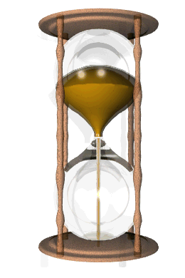
Bad Algorithms Can Kill a Program!
Bad algorithms can produce bad results:
Bad algorithms can be way too slow!

Slide 21
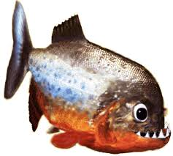
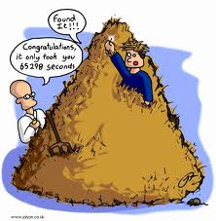
Algorithm Comparison “Guess My Word”
Let’s say you’re building a word guessing game.
The user secretly picks a random word from the dictionary.
ichthyology
Our program then must figure out what word the user picked.
Let’s consider some different algorithms…

Slide 22
Algorithm Comparison
Well, one algorithm we could use would be to randomly pick words from the dictionary:
While I haven’t guessed the user’s word
{
Select a random word w from the dictionary
Ask the user if w was the word they picked
}
Ok, let’s try it.
Question: If there are N total words in our dictionary, on average, how many guesses will our algorithm require?
Notes:
Answer: roughly N guesses total if there are N words in the dictionary. This assumes that the random number generator can pick the same word multiple times. If you never select a random word that you’ve already guessed, then it would require roughly N/2 guesses on average

Slide 23
Algorithm Comparison
Let’s try a second algorithm: We’ll search linearly from top to bottom and ask the user about each word:
j = 0
While I haven’t guessed the user’s word
{
Select word j from the dictionary
Ask the user if word j is the word they picked
j = j + 1
}
Ok, let’s try it.
Question: If there are N total words in our dictionary, on average, how many guesses will our algorithm require?
Notes:
Answer: Roughly N/2 guesses, on average, to guess the user’s word

Slide 24
Algorithm Comparison
Alright, for our third strategy let’s try a more intelligent approach called binary search:
SearchArea = The entire dictionary
While I haven’t guessed the user’s word
{
Pick the middle word w in the SearchArea
Ask the user: “Is w your word?”
If so, you’re done! Woohoo!
If not, ask: “Does your word come before or after w?”
If their word comes before our middle word w
SearchArea = first ½ of the current SearchArea
If their word comes after our middle word w
SearchArea = second ½ of the current SearchArea
}
Ok, let’s try it.
Question: If there are N total words in our dictionary, on average, how many guesses will our algorithm require?
Notes:
Answer, log (n) (that’s log with a base of 2)
2

Slide 25
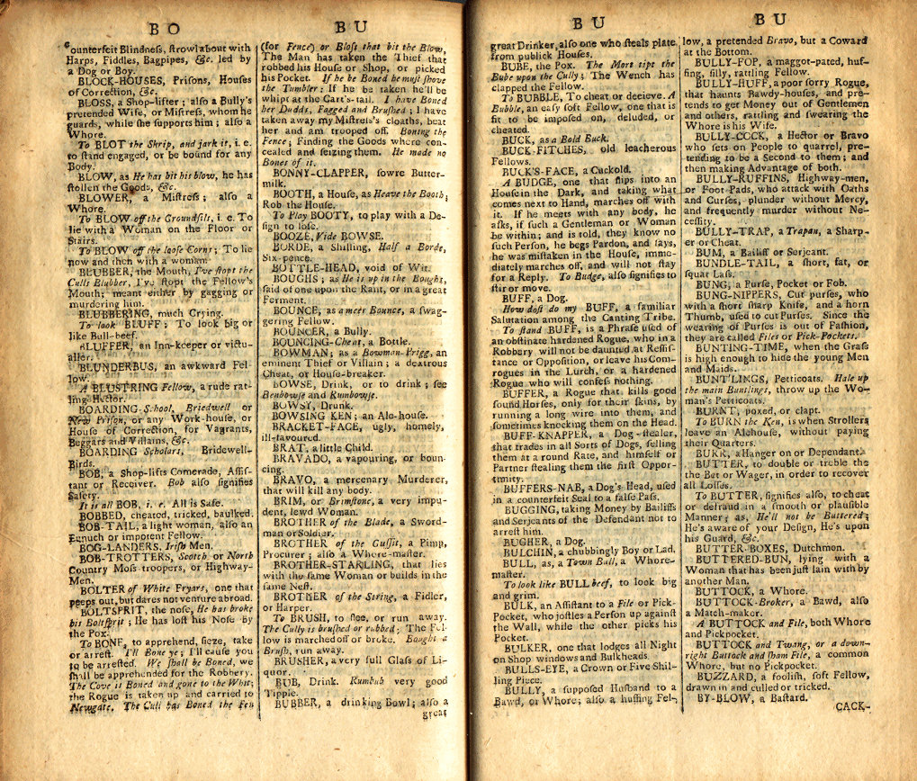
Hmmm. How Many Guesses?
We keep on dividing our search area in half until we finally arrive at our word.
In the worst case, we must keep halving our search area until it contains just a single word – our word!
If our dictionary had N=16 words, how many times would we need to halve it until we have just one word left?
16
8
4
2
1
It would take 4 steps
Ok, what if our dictionary had N=131,072 words?
131072
65536
32768
16384
8192
4096
2048
1024
512
256
128
64
32
16
8
4
2
1
It would take just 17 steps!!! WOW!
Can we come up with a general formula to determine the # of steps?

Slide 26
Binary Search
Well, if you remember your math…
You know that log₂(N) is equal to the number of times you can divide N by 2 before you reach a value of 1.
log₂(8) = 3, since 8 → 4 → 2 → 1
log₂(64) = 6, since 64 → 32 → 16 → 8 → 4 → 2 → 1
log₂(1 billion) = ? 1B → 500M → 250M → 125M→ …
So no matter what word the user picks, we can find it in log₂(N) steps for a dictionary with N words!

Slide 27
Wow! That’s Significant!
Our random search algorithm requires N steps, on average, to guess the user’s secret word.
(~100,000 steps for a dictionary with 100,000 words)
Our linear search algorithm requires N/2 steps, on average, to guess the user’s secret word.
(~50,000 steps for a dictionary with 100,000 words)
But our binary search algorithm only requires log₂(N) steps, on average, to guess the user’s secret word.
(~17 steps for a dictionary with 100,000 words)
If, instead of a dictionary, we had to search a database of 300 million people, which algorithm would you choose?

Slide 28
Data Structures
A data structure is the data that’s operated on by an algorithm to solve a problem.
Sometimes an algorithm can operate just on the data passed in to it.
Other times your algorithm will have to create its own secondary data structures to solve a problem.
What was the data structure we operated on in the Fibonacci algorithm?
Right, just the array of integers:
int arr[100] = {0,1,1,2,3,5,8,13,21,…};

Slide 29
A Data Structure for Facebook
Imagine that you’re building a social network website like Facebook…
UserA made friends w/ UserB
Danny Hsu – Jenny Oh
Danny Hsu – Rich Lim
Jenny Oh – David Sun
Danny Hsu – Carey Nash
Carey Nash – Scott Wilhelm
Melani Kan – Danny Hsu
Carey Nash – David Small
Jenny Oh – Len Kleinrock
Jenny Oh – Mario Giso
Mario Giso – Rich Nguyen
And you want to keep track of who made friends with who…
How would you do it?
Well, one valid data structure might be an unordered list of friendships, like this…
Now how could I find out if Melani Kan is a friend of Danny Hsu?
Hmmm. If we had 100 million users with 10 billion friendships, that search might be a bit too slow! ☺
Well, we could search through every pair of friends until we find the friendship we were looking for…

Slide 30
A Better Friendship Data Structure
What if instead we assigned each of our N users a number…
Now given a user’s name, how can we quickly find their number?
Right – just use a Binary Search!
Now, to see if two people are friends, all we need to do is…
Look up their numbers A, B
Check (A,B) or (B,A) in our array
If we find a *, they’re buddies!
And keep an alphabetized list of each user → number pair.
Cool – and once we have both users’ numbers, we can use them and a two-dimensional array to represent relationships!
User Number
Carey Nash 0
Danny Hsu 1 David Small 2
David Sun 3
Jenny Oh 4
Len Kleinrock 5
Mario Giso 6
Melani Kan 7
Rich Lim 8
Rich Nguyen 9
Scott Wilhelm 10
0
1
 | 0 | 1 | 2 | 3 | 4 | 5 | 6 | 7 | 8 | 9 | 10
0
1
2
3
4
5
6
7
8
9
10
3
*
*
4
*
UserA made friends w/ UserB
Danny Hsu – Jenny Oh
David Sun – Carey Nash
Jenny Oh – David Sun
Danny Hsu – Carey Nash
Carey Nash – Scott Wilhelm
Melani Kan – Danny Hsu
Carey Nash – David Small
Jenny Oh – Len Kleinrock
Jenny Oh – Mario Giso
Mario Giso – Rich Nguyen
*
*
*
*
*
*
*
*
*
*
*
*
*
*

Slide 31
A Better Friendship Data Structure
So what we’ve done is created a new data structure that makes it faster to determine if two people are friends!
Coupled with our new, more efficient algorithm, we can quickly find out if two people are friends!
User Number
Carey Nash 0
Danny Hsu 1 David Small 2
David Sun 3
Jenny Oh 4
Len Kleinrock 5
Mario Giso 6
Melani Kan 7
Rich Lim 8
Rich Nguyen 9
Scott Wilhelm 10
0
1
2
3
4
5
6
7
8
9
10
0
*
*
*
1
*
2
*
3
*
*
*
*
4
*
*
*
*
5
*
Friend-finding Algorithm:
Look up their numbers A, B
Check (A,B) or (B,A) in our array
If we find a *, they’re buddies!
6
*
7
*
8
*
*
9
*
10
*

Slide 32
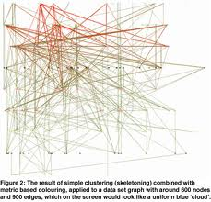
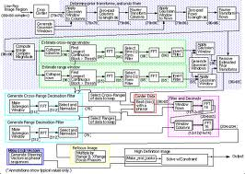
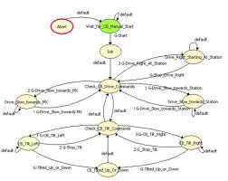
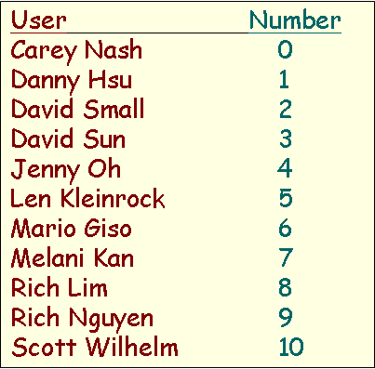
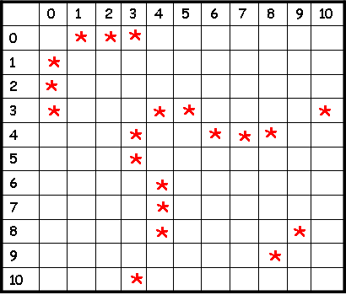

Data Structures + Algorithms = Confusion!
Of course, your data structures and algorithms can get quite complex.
Friend-finding Algorithm:
1. Look up their numbers A, B
2. Check (A,B) or (B,A) in our array
3. If we find a *, they’re buddies!
Such a collection of simple functions is called an “interface.” An interface lets any programmer use your code without knowing the sordid details!
If you gave your code to another programmer, he/she would have no idea how to use it!
Therefore, every time you create a new set of data structures/algorithms, it helps to also create a few simple functions that hide the gory details…
bool AreTheyFriends(string UserA, string UserB)
void BecomeFriends(string UserA, string UserB)
void BreakUp(string UserA, string UserB)
Then other programmers can use your code easily!

Slide 33
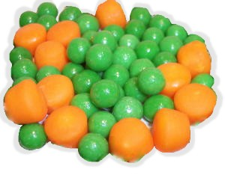
Algorithms & Data Structures Are a Perfect Couple!
Algorithms and data structures are like peas and carrots – they belong together!
To solve a problem, you have to design both the algorithms and the data structures together.
Then you provide a set of simple “interface” functions to let any programmer use them easily.
And in fact, we even have a name for such a (data structure + algorithm + interface) solution to a problem…

Slide 34
The Abstract Data Type (ADT)
An Abstract Data Type or ADT is:
“A coordinated group of (a) data structures, (b) algorithms and (c) interface functions that is used to solve a particular problem.”
I’m a set of algorithms.
No one outside of my ADT needs to know how I work.
I’m an interface.
If someone wants to use this ADT, they must call these three functions to work with it.
I’m a set of data structures.
No one outside of my ADT needs to know what I look like!
Abstract Data Type (for finding friends)
Add Friend Algorithm:
1. Look up each person’s #s
2. Stick a * in grid[n1][n2]
3. Stick a * in grid[n2][n1]
Friend-finding Algorithm
1. Look up each person’s #s
2. Check grid[n1][n2] and grid[n2][n1]
3. If we find a *, they’re buddies!
+
+
bool AreTheyFriends(UserA,UserB)
void BecomeFriends(UserA,UserB)
void BreakUp(UserA,UserB)
…
In an ADT, the data structures and algorithms are secret.
The ADT provides an interface (a simple set of functions) to enable the rest of the program use the ADT.
Typically, we build programs from a collection of ADTs, each of which solves a different sub-problem.

Slide 35

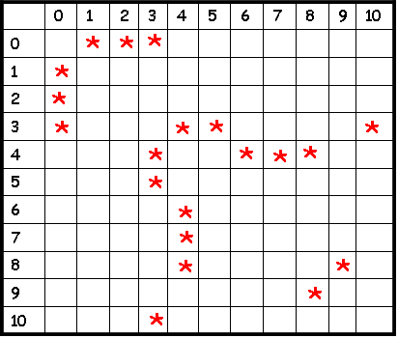
ADTs in C++
User Number
Carey Nash 0
Scott Wilhelm 1
David Smallberg 2
Danny Hsu 3 Jenny Oh 4
Rich Lim 5
David Sun 6
…
We can use C++ classes to define ADTs in our C++ programs!
Each C++ class can hold algorithms, data and interface funcs.
Friend-finding Algorithm:
1. Look up their numbers A, B
2. Check (A,B) or (B,A) in our array
3. If we find a *, they’re buddies!
// define a C++ class for friends
// (this is really an ADT!)
class FriendFinder
{
};
int main()
{
FriendFinder x;
x.BecomeFriends(“Carey Nash”, ”Scott Wilhelm”);
x.BecomeFriends(“Jenny Oh”,
”David Sun”);
…
string userA, userB;
cin >> userA >> userB;
if (x.AreTheyFriends(userA, userB) == true)
cout << userA << “ is friends with “ << userB;
}
Once we’ve defined our class, the rest of our program can use it trivially.
All our program needs to do is call the functions in our class’s public interface!
And yet all of its underlying data structures and algorithms are hidden!
The rest of the program can ignore how exactly our class works and just use it’s features!
This is the power of the ADT/class!
// our interface functions go here
void BecomeFriends(…);
void AreTheyFriends(…);
...
// secret algorithms go here
…
// secret data structures go here
…

Slide 36


ADTs in C++
User Number
Carey Nash 0
Scott Wilhelm 1
David Smallberg 2
Danny Hsu 3 Jenny Oh 4
Rich Lim 5
David Sun 6
…
We use a similar approach to construct real-life objects!
Friend-finding Algorithm:
1. Look up their numbers A, B
2. Check (A,B) or (B,A) in our array
3. If we find a *, they’re buddies!
int main()
{
FriendFinder x;
x.BecomeFriends(“Carey Nash”, ”Scott Wilhelm”);
x.BecomeFriends(“Jenny Oh”,
”David Sun”);
…
string userA, userB;
cin >> userA >> userB;
if (x.AreTheyFriends(userA, userB) == true)
cout << userA << “ is friends with “ << userB;
}
Consider your car…
It has an easy-to-use interface like the steering wheel, brake and accelerator pedals.
The complicated machinery is hidden from you – you don’t need to know how it works to use it!

Slide 37
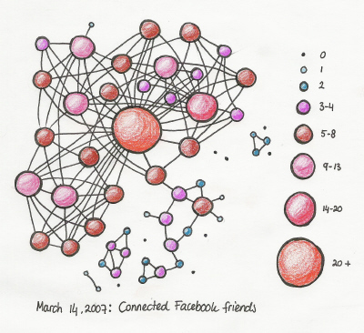
ADTs in C++
User Number
Carey Nash 0
Scott Wilhelm 1
David Smallberg 2
Danny Hsu 3 Jenny Oh 4
Rich Lim 5
David Sun 6
…
User Number
Carey Nash 0
Scott Wilhelm 1
David Smallberg 2
Danny Hsu 3 Jenny Oh 4
Rich Lim 5
David Sun 6
…
Now what if I wanted to improve my FriendFinder data structures?
Friend-finding Algorithm:
1. Identify the node in the graph for user
2. Perform a breadth-first search from this node
3. Do not follow more than 2 edges…
This is the power of ADTs (and of classes)!
If you design your programs using this approach, you can reduce complexity by:
Breaking your programs up into small, self-contained chunks.
Combining these chunks together to solve bigger (more complex) problems.
Friend-finding Algorithm:
1. Look up their numbers A, B
2. Check (A,B) or (B,A) in our array
3. If we find a *, they’re buddies!
int main()
{
FriendFinder x;
x.BecomeFriends(“Carey Nash”, ”Scott Wilhelm”);
x.BecomeFriends(“Jenny Oh”,
”David Sun”);
…
string userA, userB;
cin >> userA >> userB;
if (x.AreTheyFriends(userA, userB) == true)
cout << userA << “ is friends with “ << userB;
}
Let’s say I made a radical change to our friend network data structures…
Would the user of my class need to change any part of her program?
No! Because the rest of the program doesn’t rely on these details… It knows nothing about them!
The same is true for your car! If you replace your engine, you don’t care – you just use the steering wheel, accelerator and brakes like you did before!

Slide 38

What is Object Oriented Programming?
Objected Oriented Programming (OOP) is simply a programming model based the Abstract Data Type (ADT) concept we just learned!
In OOP, programs are constructed from multiple self-contained classes.
Each class holds a set of data and algorithms - we then access the class using a simple set of interface functions!
Classes talk to each other only by using public interface functions – each class knows nothing about how the others work inside.
So to sum up:
OOP is using classes (aka ADTs) to build programs – plus some other goodies we’ll learn soon!

Slide 39
C++ Class Review
Ok, let’s do a quick review of C++ structs and classes.
If you’ve forgotten all about classes, make sure to read up on them before our next class.
Topics to review (on your own!):
Struct variables
Basic classes
Constructors
Destructors
Const member functions
Accessing class and struct variables by pointer

Slide 40

Topic #1: C++ structs
Sometimes we want to group together multiple related pieces of data and store them in one variable.
For instance, let’s say we want to represent students.
Each student has:
A name
A student ID
A GPA
etc…
The problem is that traditional variable types, like int and float can only store a single value!
So a single float variable isn’t enough to represent a whole student.
The C++ struct allows us to define a whole new type of variable that holds multiple related pieces of data rather than just one value.

Slide 41
C++ struct types
We can use the “structure” feature in C++ to define a new data type (like int, string, float) that can store a student’s name, ID and GPA all in one variable.
First, write the word struct.
Then we give our new struct a name…
struct
STUDENT
{
}
Then we specify all of the members that our new structure contains in between { and }
string name;
int ID;
float GPA;
Finally, we add a semicolon ; at the end.
;
This defines an entirely new data type, like string, that we can now use in our program.

Slide 42
C++ struct types
Once we define our new struct type, like STUDENT, we can use it to define variables like any traditional data type.
student.h
struct STUDENT
{
string name;
int ID;
float GPA;
};
You typically define a new struct type in a header file.
student.cpp
#include “student.h”
int main()
{
STUDENT s1, s2;
float f1;
s1.name = “Jim”;
…
After you define a new struct type, you can create variables with it throughout your program.
Just as f1 is a floating-point variable…
S1 and s2 are a student variables…

Slide 43
C++ struct types
student.h
struct STUDENT
{
string name;
int ID;
float GPA;
};
student.cpp
#include “student.h”
int main()
{
STUDENT t, u;
t.name = “Carey”;
t.ID = 113353948;
t.GPA = 3.99;
u.name = “David”;
u.GPA = 1.12;
Let’s see how we can use our new struct type in action!
We access t’s members like this:
t . member = value;
t
u
“David”
“Carey”
name
name
ID
113353948
ID
1.12
GPA
3.99
GPA
Neato! C++ structs let us group related data together into one common unit.
But wait! Wouldn’t it be cool if our struct could also hold algorithms to operate on that data, as well as interface functions?
Then we could represent a complete, self-contained Abstract Data Type!

Slide 44
Topic #2: C++ classes
Consider the following structure and associated function(s).
struct Rect
{
int width;
int height;
};
int GetArea(Rect &a)
{
int area = a.width *
a.height;
return(area);
}
struct Rect
{
int width;
int height;
};
r
width
10
height
20
a
area
200
int main(void)
{
Rect r;
r.width = 10;
r.height = 20;
cout << GetArea(r);
10 * 20
200

Slide 45
Classes
A class is basically a struct with built-in functions in addition to member variables.
struct Rect
{
int width;
int height;
};
int GetArea(Rect &a)
{
int area = a.width *
a.height;
return(area);
}
class
struct Rect
{
int width;
int height;
};
int width;
int height;
};
)
int GetArea(Rect &a)
{
int area = a.width *
a.height;
return(area);
}

Slide 46
Using a Class
int GetArea()
{
int area = width * height;
return(area);
}
width
height
class Rect
{
int GetArea()
{
int area = width * height;
return(area);
}
int width;
int height;
};
Output:
200
r
*
int main(void)
{
Rect r;
r.width = 10;
r.height = 20;
cout << r.GetArea();
200
10
10
20
20
area
200

Slide 47
Using a Class
class Rect
{
int GetArea()
{
int area = width * height;
return(area);
}
int width;
int height;
};
Output:
25
49
r
int GetArea()
{
int area = width * height;
return(area);
}
width
height
5 * 5
area
25
25
5
5
int main(void)
{
Rect r, s;
r.width = r.height = 5;
s.width = s.height = 7;
cout << r.GetArea();
cout << s.GetArea();
s
int GetArea()
{
int area = width * height;
return(area);
}
width
height
7 * 7
area
49
49
7
7
25
49

Slide 48
Using a Class
Use local variables for temporary calculations in your member functions.
Use member variables when your class needs to store the values permanently.
r and s are variables.
In C++ lingo, you can also call them “instances” or “objects”:
“r is an instance of a Rect.
s is an instance of Rect too.”
GetArea is a “member function” of r.
To call a member function of r, write: r.functionname(params);
Since we’re in r, GetArea works on r’s member variables:
r.width and r.height…
This time, we’re calling the GetArea function of s.
class Rect
{
int GetArea()
{
int area = width * height;
return(area);
}
int width;
int height;
};
The area variable is a local variable, just like in regular functions.
It disappears once our function ends!
r.width and r.height are called “member variables”
r has its own copies of both width and height.
Clearly, s has its own copies of width and height too.
r
int GetArea()
{
int area = width * height;
return(area);
}
width
height
5
5
5
int main(void)
{
Rect r, s;
r.width = r.height = 5;
s.width = s.height = 7;
cout << r.GetArea();
cout << s.GetArea();
5
s
int GetArea()
{
int area = width * height;
return(area);
}
width
height
area
49
7
7
7
7

Slide 49
Classes
class Rect
{
int GetArea()
{
int area = width * height;
return(area);
}
We can add as many functions as we like to our class…
void Initialize(int startW, int startH)
{
width = startW;
height = startH;
}
int width;
int height;
};
int main(void)
{
Rect r;
r.width = 10;
r.height = 20;
cout << r.GetArea();
r.Initialize(10,20);

Slide 50
Public vs. Private
Oh, and there’re two more things we have to add to make our class technically correct…
class Rect
{
int GetArea()
{
int area = width * height;
return(area);
}
#1: The public keyword means: these functions can be accessed by any part of our program.
public:
I can call Rect’s member functions GetArea and Initialize since they’re public!
void Initialize(int startW, int startH)
{
width = startW;
height = startH;
}
int main(void)
{
Rect r;
r.Initialize(10,7);
cout << r.GetArea();
private:
int width;
int height;
};

Slide 51
Public vs. Private
I’m a member function, so I can access width and height.
#2: The private keyword means: these variables may only be accessed by the class’s member functions
class Rect
{
int GetArea()
{
int area = width * height;
return(area);
}
public:
I’m a member function too, so I can access width and height.
Outside functions may not access private variables, however!
width * height
I’m not a member function of Rect so I can’t access its private variables!
void Initialize(int startW, int startH)
{
width = startW;
height = startH;
}
width height
int main(void)
{
Rect r;
r.Initialize(10,7);
cout << r.GetArea();
private:
int width;
int height;
};
r.width = 10; // ERROR!

Slide 52
Using Public+Private Properly
class Rect
{
int GetArea()
{
int area = width * height;
return(area);
}
Put all variables and any internal algorithm functions in the private section to hide them…
public:
(Only your class should know what variables and algorithms it has and how they’re used!)
void Initialize(int startW, int startH)
{
width = startW;
height = startH;
}
And place all of the functions used to interface with your class in the public section… So they’re usable by the rest of your program.
private:
This is called “encapsulation.”
void myComplexAlgorithm(float angle)
{
width = height * exp(arctan(angle),2);
}
int width;
int height
};
int main(void)
{
Rect r;
r.Initialize(10,7);
cout << r.GetArea();

Slide 53

Self-contained Problem Solvers
Each class is a self-contained, problem-solving unit… an ADT!
It contains all of the necessary data and algorithms to solve a certain problem – and simple interface functions to use it.
The rest of our program doesn’t need to know how it works, only how to talk to it using
simple interface functions!
Since we hide our class’s algorithms and variables …
We can improve its internal logic and variables later and the rest of our program will still work as-is!

